Slide 1
React and Redux: Lesson 3
Routing, Refs, Forms, Performance Optimization, Higher Order Components, React DevTools
William Abboud
* Covers React v15 - 16

Slide 2

Routing
Photo by Bruno Bergher on Unsplash

Slide 3
React Router v4
Repo:
https://github.com/ReactTraining/react-router/tree/master/packages/react-router-dom
Docs: https://reacttraining.com/react-router/web/guides/philosophy
React router offers declarative dynamic routing and stands out from conventional based static routing by letting you define your your app routes as it renders.

Slide 4
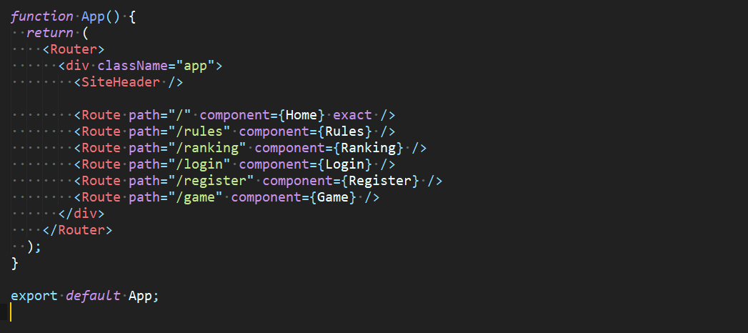
React Router v4 - Example
Wrapp app in Router Component
Specify routes with Route component
Render component on path match
Define path for the component to match

Slide 5
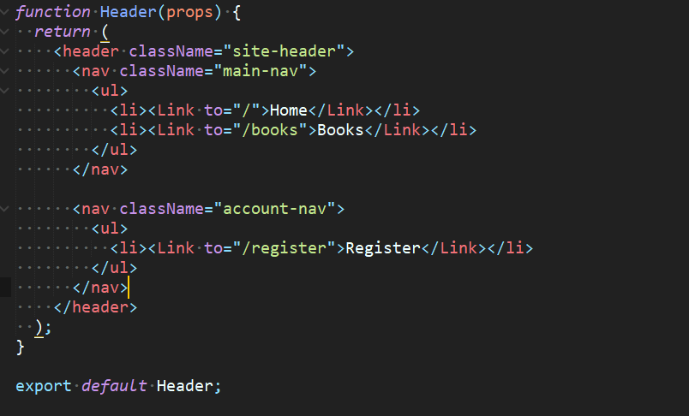
React Router v4 - Example
Link component acts a an anchor
Default path
Specific path

Slide 6
React Forms
Docs: https://reactjs.org/docs/forms.html
React handles forms a bit differently than other HTML elements.
There are 2 types of form components: Controlled and Uncontrolled.

Slide 7
Controlled Forms
Docs: https://reactjs.org/docs/forms.html
Controlled Form components are such components where the state of the form is controlled in the react component rather than the DOM itself.

Slide 8
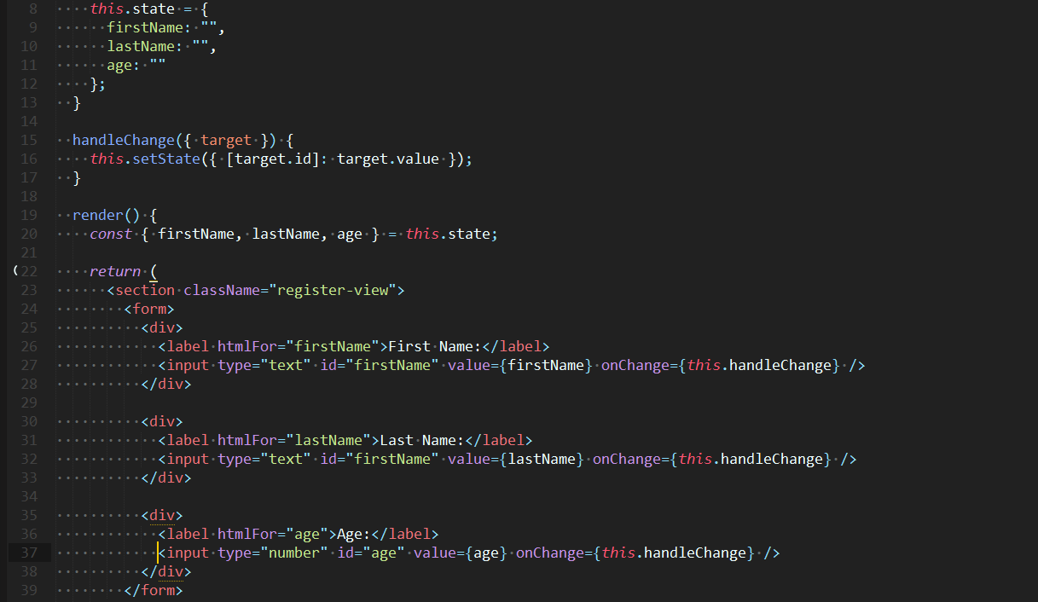

Slide 9
Uncontrolled Forms
Docs: https://reactjs.org/docs/uncontrolled-components.html
Uncontrolled Form components are such components where the state of the form is controlled in the DOM itself. Meaning React has nothing to do with how the values are changed and saved everything is handled natively by the DOM.

Slide 10
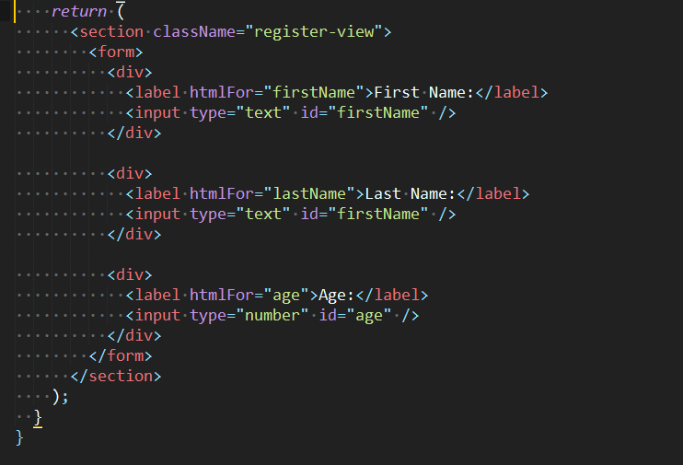

Slide 11
Refs
Docs: https://reactjs.org/docs/refs-and-the-dom.html
Refs is a feature of React which lets you access the underlying DOM element your React element or component corresponds to.
To use refs just define the “ref” prop on a react element or component and for value pass in a function which will take the DOM element as its first parameter.
Refs are only used on class components and not functional components.

Slide 12
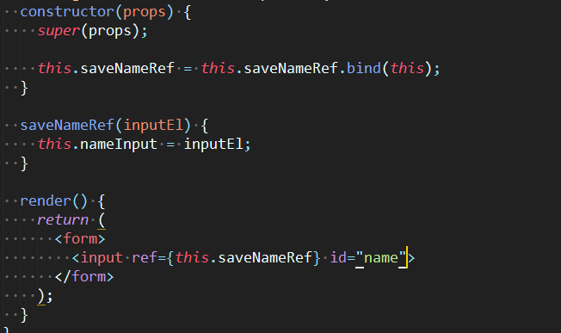

Slide 13
Refs Continued...
Refs are set when a component is mounted and unmounted.
A common gotcha especially when you are testing React components which rely on refs is that when a component is unmounted then refs will be set to null so it’s important to always do a null check. Always access a ref dependant value in componentDidMount.

Slide 14
Performance
Do not optimize prematurely
Identify performance issues further up the hierarchy
Install React DevTools to monitor wasted renders
Use Chrome DevTools Performance Tab to view slow functions
Extend React.PureComponent
Implement your own version of shouldComponentUpdate

Slide 15
shouldComponentUpdate
The lifecycle method shouldComponentUpdate is your first stop when you try to fix your react component’s wasted render performance.
shouldComponentUpdate returns a boolean value and is responsible for any consecutive rerenders.
It can be very difficult to nail it right but it does offer a lot of benefits.

Slide 16
shouldComponentUpdate Continued...
Do not compare children elements
Only compare props and state simple values or arrays of simple values
Make sure you get it right

Slide 17
High Order Components (HOC)
Docs: https://reactjs.org/docs/higher-order-components.html High Order Components is an emerging pattern in React which is used to reuse component logic. In essence a high order component is just a function that takes a component and returns a component. It is useful when you have to give more than one component additional information.

Slide 18
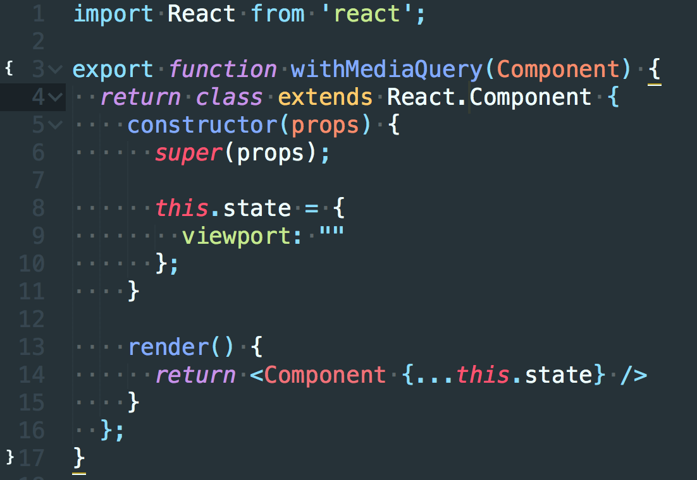
Return wrapped up class
Return the passed component in the render
Pass additional information

